Slide 1
1. What are the hot science topics for SPICA in galaxy evolution?
From the science goals to the SPICA science requirements
  Galaxy evolution case:
    Mapping BHAR and SFR through spectroscopy at 0<z<4
    Feedback & Feeding in the context of galaxy evolution
    Chemical Evolution of Galaxies: The Rise of Metals and Dust
    Towards the epoch of Re-Ionization through photometric surveys
    Towards the epoch of Re-Ionization through deep SAFARI spectroscopy
    Explore:
    SPICA-SMI 34µm +B-BOP 60-70µm large-area deep surveys will provide 2-band continuum fluxes for unbiased samples of tens of thousands of galaxies

Slide 2
Galaxy evolution is obscured by dust at redshifts of z~1-3
Spitzer + Herschel photometric surveys
➔ bolometric luminosities of galaxies
➔ estimates of the SFR and BHAR density functions.
However,
AGN/SF separation is not based on observed physical quantities but is model-dependent (used local SED templates, with large uncertainty and degeneracy).
UV/opt. spectroscopy (from e.g. SLOAN) track only marginally (∼10%) the total integrated light.
BHAR X-ray estimates are affected by the large uncertainties of the adopted bolometric corrections.
SFR density at z>2-3 very uncertain, since it is from UV surveys, highly affected by dust extinction.
White paper by LS et al. (2017, PASA)

Slide 3
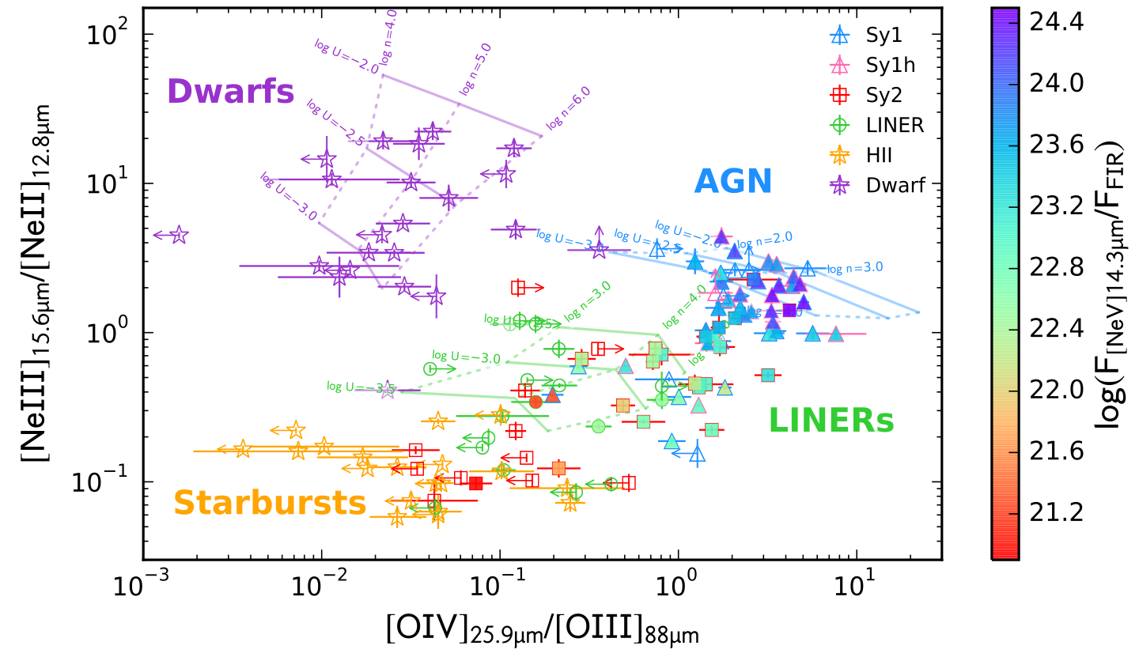
Fernandez-Ontiveros+2016, ApJS
SPICA will study both obscured starbursts and AGN across cosmic history, from a time when the Universe was only 1-2 billion years old.
The new “IR BPT DIAGRAM”
White paper by LS et al. (2017, PASA)
The new BPT diagram distinguishes any type of AGN (Seyfert and LINER) from any type of Star Formation dominated galaxy (either Starburst or Dwarf galaxies).
Notes:
Models reproduce [NeIII]/[NeII], but not [OIV]/[OIII]. Models predict a metallicity dependence of both the [NeIII]/[NeII] and [OIV]/[OIII]. Observations prove the first, but the observed [OIV]/[OIII] ratio span the same range for starbursts and dwarf galaxies. It does not correlate with metallicity.
[OIV] detected previously in starburst galaxies (Lutz et al. 1998), associated to X-ray emission by shocks in the stellar atmospheres or X-ray binaries (Sellmaier et al. 1996; Izotov et al. 2012; Stasinska et al. 2015), or to strong winds during the Wolf-Rayet phase of massive stars with ages of 3-5 Myr (Schaerer & Stasinska 1999). The latter could be the case for dwarf galaxies, since WR are common at low metallicites, but not for the starburst galaxies. Since the stellar contribution decreases considerably above 54 eV, even a small contribution from, e.g. shocks, would increase the [OIV]/[OIII] ratio considerably.
- Il nuovo BTP distingue AGN di quasiasi altro tipo di formazione stellare.
- I modeli di starburst, e anche quelli di dwarfs, subestimano il rapporto di [OIV]/[OIII].
E in base a questo se può fare il discorso che è scritto adesso. Questi fotoni ionizanti che mancano in starburst prottebbero venire di shocks, X-ray binaries, rapidly rotating O stars, etc. Ma debe essere un fattore indipendente della metallicità, pero noi non vediamo nessuna dipendenza in [OIV]/[OIII].
Per i LINERs noi ussiamo una slope di -3.5 perche si aspetta che il disco di acrezione sparisce in sorgenti che sono molto sub-eddington (log(L/Ledd) < -3; ). Qua ci sono delle reference:
- Absence of the big blue bump in LINER spectra and steeper optical-to-UV continuum when compared with brighter AGN (Ho 1996, 1999; Halpern et al. 1999).
- Predicted recession of the innermost part of the accretion disk in radiatively inefficient AGN (Narayan & Yi 1995).
I LINER sono una classe molto eterogenea, noi non vogliamo dire che tutti i LINERs hanno uno spettro con una slope di -3.5. Ma invece vogliamo dire che se il disco di accrezione regredisce, allora i rapporti delle righe diventano più simile a quelli degli starburst.

Slide 4
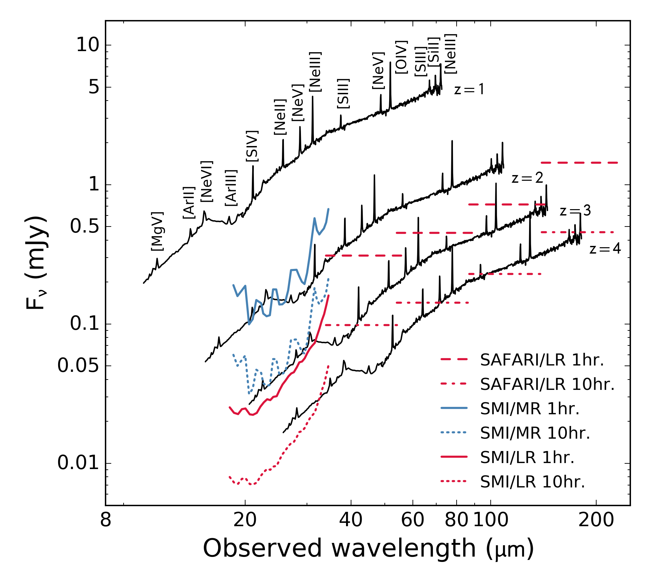
Line detectability with the SPICA spectrometers SAFARI & SMI
The IR spectrum of MCG-3-34-64, a nearby active galaxy, rescaled to a luminosity of L=10¹² L at redshifts z from 1 to 4. At z=3, the ”main sequence luminosity" L*=10¹² L, implying that we will map the "bulk" of the galaxy population up to this redshift. The SAFARI and SMI sensitivities (in medium and low resolution) are shown.
White paper by LS et al. (2017, PASA)

Slide 5
Line detectability with the SPICA spectrometers SAFARI & SMI
AGNs
Starbursts

Slide 6
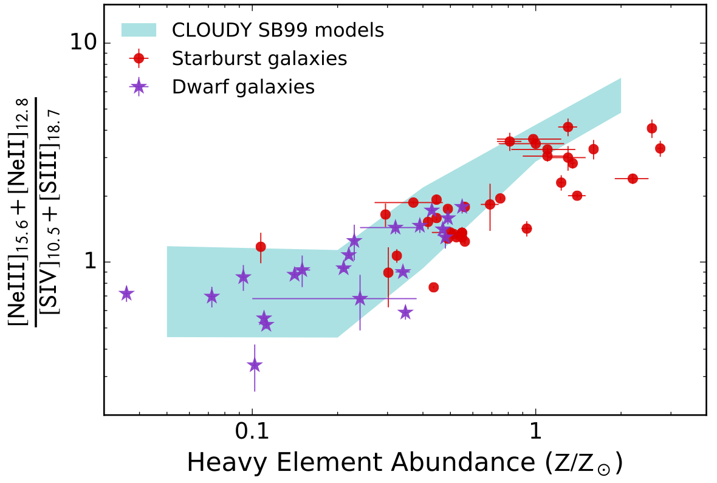
SPICA and the Chemical Evolution of Galaxies: The Rise of Metals and Dust white paper by Juan Antonio Fernandez-Ontiveros et al. (2017, PASA)
Models for (2.2x[Oiii]88μm+[Oiii]52μm)/[N iii]57μm
as a function of the gas-phase metallicity (Nagao+2011). For each metallicity bin, starburst models at given ionisation are indicated by a circle, AGN models with a square. Figure from Pereira- Santaella et al. (2017).
([Neii]12.8μm+[Ne iii]15.6μm)/([S iii]18.7μm+ [S iv] 10.5μm) line ratio from Spitzer /IRS observations of starburst galaxies in the Local Universe vs. indirect gas-phase metallicity determined from strong optical lines (Moustakas et al. 2010; Pilyugin et al. 2014). Cloudy models including sulphur depletion above Z > 1/5 Zo are in agreement with the observations (adapted from Fernandez-Ontiveros et al. 2016).

Slide 7
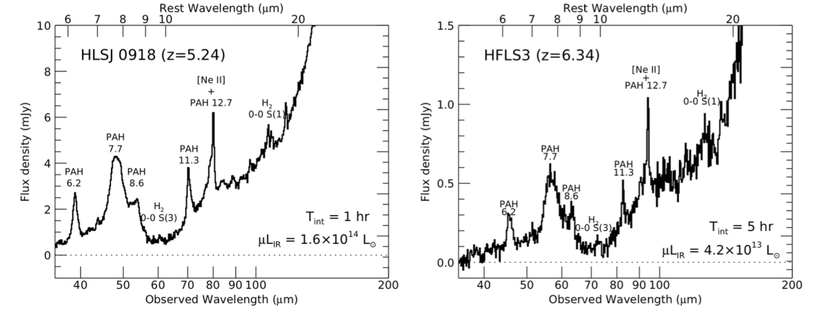
Probing the High-Redshift Universe with SPICA spectroscopy
SAFARI will collect rest-frame mid-IR spectra up to z~10 for sufficiently luminous galaxies (L_{IR}>2x10¹³L).
These galaxies, mostly gravitationally lensed, are being discovered at z>5, (e.g. Combes et al. 2012; Riechers et al. 2013). SPICA will offer the first opportunity to study the rest-frame mid-IR spectra of galaxies at z>4-5 and up to z~10 in significant numbers.
Simulated SAFARI spectra of HLSJ0918 and HFLS3 produced with the L_{IR}~10¹² L galaxy spectral template (Rieke et al. 2009), scaled to µL_{IR}=16 and 4x10¹³ L, respectively. These are both gravitationally lensed by factors of 9 and 2, respectively.
White paper by Eiichi Egami et al. (2018, PASA, in press)

Slide 8
How science requirements give the needed sensitivity for spectroscopy
Slice at z=1:
Log(L) (Lo) | F_o4 (W/m2) | F_ne2 (W/m2) | F_ne5 (W/m2)
11.00 | 3.498e-20 | 3.406e-20 | 1.212e-20
11.50 | 9.649e-20 | 1.315e-19 | 3.742e-20
12.00 | 2.662e-19 | 5.077e-19 | 1.155e-19
12.50 | 7.343e-19 | 1.960e-18 | 3.567e-19
13.00 | 2.026e-18 | 7.567e-18 | 1.101e-18
13.50 | 5.588e-18 | 2.922e-17 | 3.400e-18
The case is very simple:
We want to measure the bulk of the Star Formation Rate (SFR) and of the Black Hole Accretion Rate (BHAR) through cosmic time up to the peak of these functions i.e. at redshift of z=3.
To do this we need to detect the chosen tracers (namely the [OIV]26µm line for BHAR and the [NeII]12.8µm lie for SFR) in the “typical” galaxies which produce most of the emission, i.e. the galaxies lying at the knee of the luminosity functions, at the three chosen redshifts of z=1, 2, 3, which also corresponds to the so-called “main sequence galaxies”.
We therefore adopt as limiting luminosity the “main-sequence” luminosity (in light blue)
We list in the table the expected fluxes of these galaxies at the various redshifts and luminosities.
Slice at z=2:
Log(L) (Lo) | F_o4 (W/m2) | F_ne2 (W/m2) | F_ne5 W/m2)
11.50 | 1.732e-20 | 2.360e-20 | 6.715e-21
12.00 | 4.777e-20 | 9.111e-20 | 2.073e-20
12.50 | 1.318e-19 | 3.518e-19 | 6.401e-20
13.00 | 3.635e-19 | 1.358e-18 | 1.976e-19
13.50 | 1.003e-18 | 5.243e-18 | 6.102e-19
Slice at z=3:
Log(L) (Lo) | F_o4 (W/m2) | F_ne2 (W/m2) | F_ne5 (W/m2)
12.00 | 1.777e-20 | 3.390e-20 | 7.714e-21
12.50 | 4.903e-20 | 1.309e-19 | 2.381e-20
13.00 | 1.353e-19 | 5.053e-19 | 7.353e-20
13.50 | 3.731e-19 | 1.951e-18 | 2.270e-19

Slide 9
CURRENT SPECTROSCOPIC SURVEYS (7X10^-20 W/m^2 5𝛔 1 hr.) Slice at z=1: [NOTE: MIN. OBSERVING TIME on-source SET TO 0.1 hrs.] Log(L) F_o4 time_o4 F_ne2 time_ne2 F_ne5 time_ne5 adopted time 11.00 3.498e-20 4.004 3.406e-20 4.224 (1.212e-20 33.36) 4.2 hrs. 11.50 9.649e-20 0.526 1.315e-19 0.283 3.742e-20 3.500 3.5 hrs. 12.00 2.662e-19 0.069 5.077e-19 0.019 1.155e-19 0.367 0.46 hrs. 12.50 7.343e-19 0.009 1.960e-18 0.001 3.567e-19 0.038 0.1 hrs. 13.00 2.026e-18 0.001 7.567e-18 0.000 1.101e-18 0.004 0.1 hrs. 13.50 5.588e-18 0.000 2.922e-17 0.000 3.400e-18 0.000 0.1 hrs. total time for z=1 bin = Σ_{L_bin=1,6} (time) x 60 sources = 8.5 x 60 sources = 510 hours Slice at z=2: Log(L) F_o4 time_o4 F_ne2 time_ne2 F_ne5 time_ne5 adopted time 11.50 1.732e-20 16.3 2.360e-20 8.800 (6.715e-21 108) 16.3 hrs. 12.00 4.777e-20 2.147 9.111e-20 0.590 2.073e-20 11.4 11.4 hrs. 12.50 1.318e-19 0.282 3.518e-19 0.040 6.401e-20 1.196 1.44 hrs. 13.00 3.635e-19 0.037 1.358e-18 0.003 1.976e-19 0.125 0.16 hrs. 13.50 1.003e-18 0.005 5.243e-18 0.000 6.102e-19 0.013 0.1 hrs. total time for z=2 bin = Σ_{L_bin=1,5} (time) x 60 sources = 29.4 x 60 sources = 1764 hours Slice at z=3: Log(L) F_o4 time_o4 F_ne2 time_ne2 F_ne5 time_ne5 adopted time 12.00 1.777e-20 15.5 3.390e-20 4.264 (7.714e-21 82.3) 15.5 hrs. 12.50 4.903e-20 2.040 1.309e-19 0.286 2.381e-20 8.64 8.6 hrs. 13.00 1.353e-19 0.268 5.053e-19 0.019 7.353e-20 0.906 0.9 hrs. 13.50 3.731e-19 0.035 1.951e-18 0.001 2.270e-19 0.095 0.1 hrs. total time for z=3 bin = Σ_{L_bin=1,4} (time) x 60 sources = 25.1 x 60 sources = 1506 hours Total Observing time on-source (without overheads) = 3780 hours for 900 sources

Slide 10
BASELINE SPECTROSCOPIC SURVEYS (5X10^-20 W/m^2 5𝛔 1 hr.) Slice at z=1: [NOTE: MIN. OBSERVING TIME on-source SET TO 0.1 hrs.] Log(L) F_o4 time_o4 F_ne2 time_ne2 F_ne5 time_ne5 adopted time 11.00 3.498e-20 2.044 3.406e-20 2.155 (1.212e-20 17.02) 2 hrs. 11.50 9.649e-20 0.269 1.315e-19 0.145 3.742e-20 1.786 2 hrs. 12.00 2.662e-19 0.035 5.077e-19 0.010 1.155e-19 0.187 0.25 hrs. 12.50 7.343e-19 0.005 1.960e-18 0.001 3.567e-19 0.020 0.25 hrs. 13.00 2.026e-18 0.001 7.567e-18 0.000 1.101e-18 0.002 0.1 hrs. 13.50 5.588e-18 0.000 2.922e-17 0.000 3.400e-18 0.000 0.1 hrs. total time for z=1 bin = Σ_{L_bin=1,6} (time) x 60 sources = 4.7 x 60 sources = 282 hours Slice at z=2: Log(L) F_o4 time_o4 F_ne2 time_ne2 F_ne5 time_ne5 adopted time 11.50 1.732e-20 8.337 2.360e-20 4.489 (6.715e-21 55.4) 8 hrs. 12.00 4.777e-20 1.096 9.111e-20 0.301 2.073e-20 5.82 6 hrs. 12.50 1.318e-19 0.144 3.518e-19 0.020 6.401e-20 0.610 1 hr. 13.00 3.635e-19 0.019 1.358e-18 0.001 1.976e-19 0.064 0.5 hr. 13.50 1.003e-18 0.002 5.243e-18 0.000 6.102e-19 0.007 0.25 hr. total time for z=2 bin = Σ_{L_bin=1,5} (time) x 60 sources = 15.75 x 60 sources = 945 hours Slice at z=3: Log(L) F_o4 time_o4 F_ne2 time_ne2 F_ne5 time_ne5 adopted time 12.00 1.777e-20 7.914 3.390e-20 2.176 (7.714e-21 42.01) 8 hrs. 12.50 4.903e-20 1.040 1.309e-19 0.146 2.381e-20 4.41 4.5 hrs. 13.00 1.353e-19 0.137 5.053e-19 0.010 7.353e-20 0.462 0.5 hrs. 13.50 3.731e-19 0.018 1.951e-18 0.001 2.270e-19 0.049 0.5 hrs. total time for z=3 bin = Σ_{L_bin=1,4} (time) x 60 sources = 13.5 x 60 sources = 810 hours Total Observing time on-source (without overheads) = 2040 hours for 900 sources

Slide 11
GOAL SPECTROSCOPIC SURVEYS (3X10^-20 W/m^2 5𝛔 1 hr.) Slice at z=1: [NOTE: MIN. OBSERVING TIME on-source SET TO 0.1 hrs.] Log(L) F_o4 time_o4 F_ne2 time_ne2 F_ne5 time_ne5 adopted time 11.00 3.498e-20 0.735 3.406e-20 0.775 (1.212e-20 6.126) 0.8 hrs. 11.50 9.649e-20 0.097 1.315e-19 0.052 3.742e-20 0.643 0.6 hrs. 12.00 2.662e-19 0.013 5.077e-19 0.003 1.155e-19 0.067 0.1 hrs. 12.50 7.343e-19 0.002 1.960e-18 0.000 3.567e-19 0.007 0.1 hrs. 13.00 2.026e-18 0.000 7.567e-18 0.000 1.101e-18 0.000 0.1 hrs. 13.50 5.588e-18 0.000 2.922e-17 0.000 3.400e-18 0.000 0.1 hrs. total time for z=1 bin = Σ_{L_bin=1,6} (time) x 60 sources = 1.80 x 60 sources = 108 hours Slice at z=2: Log(L) F_o4 time_o4 F_ne2 time_ne2 F_ne5 time_ne5 adopted time 11.50 1.732e-20 3.000 2.360e-20 1.616 (6.715e-21 19.9) 3 hrs. 12.00 4.777e-20 0.394 9.111e-20 0.108 2.073e-20 2.094 2 hrs. 12.50 1.318e-19 0.052 3.518e-19 0.007 6.401e-20 0.220 0.3 hr. 13.00 3.635e-19 0.007 1.358e-18 0.000 1.976e-19 0.023 0.1 hr. 13.50 1.003e-18 0.001 5.243e-18 0.000 6.102e-19 0.002 0.1 hr. total time for z=2 bin = Σ_{L_bin=1,5} (time) x 60 sources = 5.5 x 60 sources = 330 hours Slice at z=3: Log(L) F_o4 time_o4 F_ne2 time_ne2 F_ne5 time_ne5 adopted time 12.00 1.777e-20 2.850 3.390e-20 0.783 (7.714e-21 15.12) 3.6 hrs. 12.50 4.903e-20 0.374 1.309e-19 0.052 2.381e-20 1.587 2.0 hrs. 13.00 1.353e-19 0.049 5.053e-19 0.004 7.353e-20 0.166 0.22 hrs. 13.50 3.731e-19 0.006 1.951e-18 0.000 2.270e-19 0.017 0.1 hrs. total time for z=3 bin = Σ_{L_bin=1,4} (time) x 60 sources = 5.84 x 60 sources = 355 hours Total Observing time on-source (without overheads) = 760 hours for 900 sources

Slide 12
Summary science requirements: needed sensitivity for spectroscopy
[OIV] line fluxes as a function of z and Luminosity | Grating + 2m tel. NEP=2x10^-19 W/√Hz | Grating + 2.5m tel NEP=2x10^-19 W/√Hz | Grating + elliptical tel. 3m equivalent NEP=2x10^-19 W/√Hz or 2.5m tel + det. NEP ≤ 1.4x10^-19 W/√Hz | Grating + elliptical tel. 3m equivalent NEP=2x10^-19 W/√Hz or 2.5m tel + det. NEP ~ 1.0x10^-19 W/√Hz
Line sensitivity 5 sigma 1 hour (W/m2) | 1.12E-19 | 7.2E-20 current | 5.0E-20 requirement | 3.0E-20 goal
 | Max int.t./source Total survey time | Max int.t/source Total survey time | Max int.t./source Total survey time | Max int.t./source Total survey time
z=1, L≥10^11 Lo 360 sources | 10.5 hours 1308 hours | 4.2 hours 510 hours | 2 hours 282 hours | 0.8 hours 108 hours
z=2, L≥10^11.5 Lo 300 sources | 42 hours Not feasible | 16.3 hours 1764 hours | 8 hours 945 hours | 3.0 hours 330 hours
z=3, L≥10^12 Lo 240 sources | 40 hours Not feasible | 15.5 hours 1506 hours | 8 hours 810 hours | 3.6 hours 355 hours
TOTAL SURVEY TIME | Not feasible | 3780 hours | 2037 hours | 793 hours

Slide 13
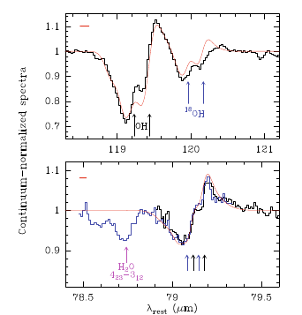
Feedback & Feeding in the context of galaxy evolution
Does feedback stop star formation?
Low spectral resolution observations to measure statistics (outflow occurrence)
→ key tracers of atomic and molecular outflows/inflows
in galaxies near the peak epoch of Star Formation (z < 2).
(P-Cygni OH profiles in Mrk 231; Fischer+2010)
White paper by Eduardo González-Alfonso et al. (2017, PASA)
1σ-1 hour
The OH doublet at 79 μm can probe outflows up to z~1.4-1.9
*OH79 shows P-Cygni in many local ULIRGs
*We use 3 templates: flux of blueshifted wings vs z
*Black curve: Safari sensitivities in LR (R=300) mode
*Continuum-normalized vs velocity is redshift-invariant
*Errorbars: +/-1σ at z=0.5, 1, 1.5 (Mrk 231, LR-2h)
Low-res. z≤1.9
Current SAFARI Low resolution (LR)
and high-resolution (HR) sensitivities

Slide 14
Feedback & Feeding in the context of galaxy evolution
High spectral resolution observations to measure physical
parameters (mass, energy, velocity…)
At high-R the OH doublet at 119 μm can be observed up to z~0.93
Outflows in other molecules, like H2O
High-res. z≤0.9
P-Cygni
High-res.
Wing in H2O
SMI will detect outflows in Ne lines
We will also explore inflows in [O I]63µm and OH
Inverse
P-Cygni
SMI
High-res.

Slide 15
Summary science requirements: needed spectral resolution
For most galaxy evolution observations:
Mapping BHAR and SFR through spectroscopy at 0<z<4
Chemical Evolution of Galaxies: The Rise of Metals and Dust
Towards the epoch of Re-Ionization through deep SAFARI spectroscopy
the required spectral resolution was set to R=500, [able to e.g. separate the [FeII] from the [OIV] fine structure lines at 26µm] however for instrumental constraints it was relaxed to R=300 which is the current baseline for SAFARI
SMI low resolution spectroscopic images (R=50-120) will be adequate for the dust and PAH features and the slope of the MIR continuum, while the medium resolution spectrometer (R=1300-2300) will be used to extend the domain of the spectroscopic surveys to lower wavelengths.
However, the observations related to:
4. Feedback & Feeding in the context of galaxy evolution
does need high resolution spectra of at least that of the PACS spectrometer. The Martin-Puplett resolution ranges from 2000 to 12000 as inverse function of wavelength (from 35 to 230µm) will be used together with the SMI medium resolution spectrometer (R=1300-2300).
The SMI high resolution channel at 12-18µm might be used for profiles exploration.

Slide 16
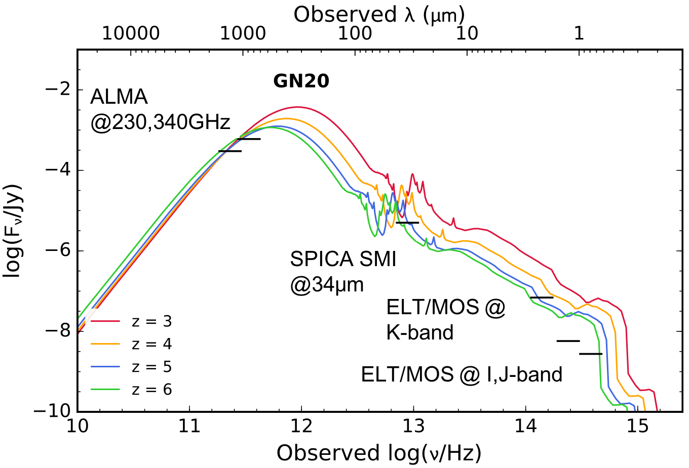
SPICA PHOTOMETRIC SURVEYS
Towards the epoch of Re-Ionization: early black holes and starbursts
SPICA SMI deep surveys will detect AGN and starburst galaxies up to z~5-6, characterized by SPICA spectral follow-up + ELTs and ALMA
0.2 deg² SMI survey at 5µJy
Left: L-z plane coverage of a 0.2 deg² SMI survey at the confusion limit (5µJy, 10 hours/frame).
Right: The SED fit to the z=4.3 starburst galaxy GN20 (Efstathiou & Siebenmorgen 2009) rescaled to L=10¹² L for z=3-6. The detection limits of ALMA (10 minutes), ELT/MOS and ELT/ MICADO (3 hours) are shown. SPICA will map large areas to the confusion limit one hundred times faster than JWST, finding large numbers of dust-enshrouded AGN and starbursts at z > 5.
White paper by Carlotta Gruppioni et al. (2017, PASA)

Slide 17
A photometric survey with SPICA
1. SMI/CAM 34µm or
2. SMI/CAM 34µm+ B-POL@60-70µm [34-60] or [34-70] colors explore the sensitivity with the confusion limit at these bands
Confusion limit for a
diffraction-limited 2.5-m telescope.
The blue curve is determined by the source density criterion, while the red one is defined by the photometric criterion.
The 5σ-confusion of SMI/CAM (34μm) is 9 μJy,
the SAFARI confusion is 0.02, 0.25 and 1 mJy at 45, 72 and 100 μm, and
18 mJy at > 200 μm.

Slide 18
What B-POL band?
60µm 3.6 times deeper than 70µm
70µm: 145µJy
60µm: 40µJy

Slide 19
A photometric survey with “only” SPICA SMI/CAM
Survey Strategy
White paper by Carlotta Gruppioni et al. (2017, PASA)
AGN2
AGN1
SF-AGN(SB)
SF-AGN(SP)
STARBURST
SPIRAL

Slide 20
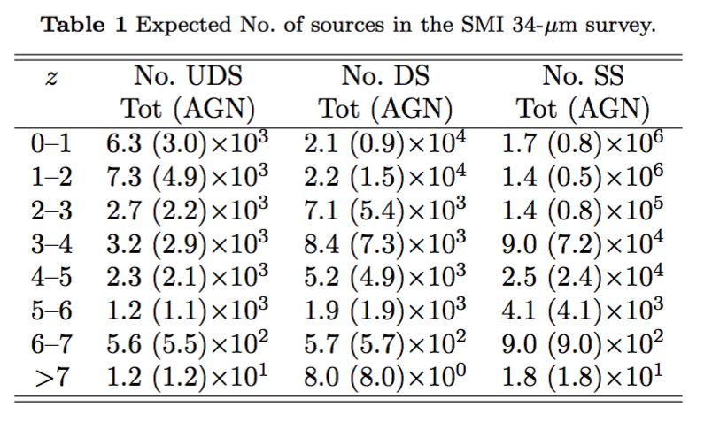
White paper by Carlotta Gruppioni et al. (2017, PASA)

Slide 21
HOW TO CONSTRAIN THE SEDs OF SMI FAINT GALAXIES
Template SED of the local CT AGN scaled by redshift up to z=5.
Fits to the observed SEDs of: the z≃4 starburst galaxy GN20 (purple) and the z=4.34 sub-mm galaxy AzTEC-1 (green).
White paper by Carlotta Gruppioni et al. (2017, PASA)

